Slide 1


Chapter 4.6 & 4.7
Name: ZHU MEIYAN
Major: Clothing & Textiles
2024.10.14

Slide 2
4.6 Counting Ones in a Window
4.6.1 The Cost of Exact Counts
To count the exact number of 1s in the last k bits, you need to store all N bits. Any representation using fewer bits than N won’t work.
If one bit in the last k bits has the same representation as another in the two different bit strings w and x, it results in a contradiction.
Essentially, minimum number of bits required to count precisely.

Slide 3
Example 4.10 shows how different bit strings can differ when querying about the last bit positions:
For w=0101 and x=1010, k=1 because they first disagree at position 1.
For w=1001 and x=0101, k=3 as they first disagree at the third position from the right.
The explanation emphasizes that to accurately count the exact number of 1's in a window of bits, you need to use all N bits. Using fewer than N bits can result in incorrect answers due to ambiguity, as different bit strings can produce the same representation. This example demonstrates the need for N bits to avoid errors in queries about the window contents.

Slide 4
4.6.2 The Datar-Gionis-Indyk-Motwani Algorithm
The DGIM Algorithm is designed to estimate the number of 1’s in a sliding window of N bits. This version of the algorithm uses O(log² N) bits to represent the window and provides an estimation with an error margin of up to 50%.
Later improvements limit the error to any fraction ϵ>0 while still using O(log² N) bits, though the constant factor increases as ϵ decreases.

Slide 5
Timestamp Representation:
We store timestamps modulo N, meaning they reset once they reach N. This way, we only need log₂N bits to represent a timestamp.
Buckets:
We divide the window into buckets. Each bucket consists of:
--The timestamp of the most recent end (right end).
--The number of 1s in the bucket, which is always a power of 2.
Bucket Representation:
Each bucket requires:
log₂N bits for the timestamp.
log₂log₂N bits to represent the number of 1s because they are powers of 2.

Slide 6

Rules for Buckets:
The right end of a bucket always has a 1.
Every position with a 1 is part of a bucket.
No position appears in more than one bucket.
There are one or two buckets for each size.
Sizes are always powers of 2.
Buckets merge when they share the same size.
This approach ensures that we can efficiently represent and manage data streams using a compact structure while maintaining accuracy.

Slide 7
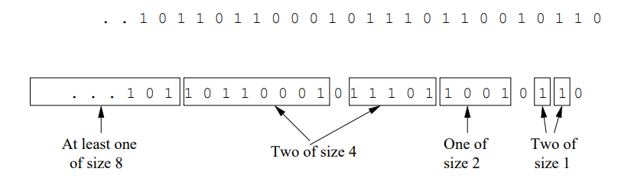
Example 4.11 shows how a bit stream can be divided into buckets according to the DGIM rules.
Bucket Sizes:
At the most recent end, there are two buckets of size 1. Moving left, there’s one bucket of size 2 (covering four positions but containing two 1’s), followed by two buckets of size 4, and potentially a bucket of size 8 further left.
Bucket Characteristics:
Some 0’s can lie between buckets.
Buckets do not overlap.
There are one or two buckets of each size up to the largest size.
Bucket sizes increase as you move left.

Slide 8
4.6.3 Storage Requirements for the DGIM Algorithm
This part explains the storage requirements for the DGIM (Datar-Gionis-Indyk-Motwani) algorithm.
It outlines that each bucket in the algorithm can be represented by O(log⁡N) bits.Given a window of length N, there are no more than N 1's. The largest bucket
size is 2ᶨ, and j cannot exceed log⁡₂N. This ensures there are at most two buckets of all sizes from log⁡₂N down to 1, and no buckets of larger sizes. Therefore, thereare O(log⁡N) buckets in total. Since each bucket can be represented in O(log⁡N) bits, the total space required for all the buckets representing a window of size N is O(log⁡²N).

Slide 9
4.6.4 Query Answering in the DGIM Algorithm
a method to estimate the number of 1's in the last k bits of a window, where 1≤k≤N.
The process involves finding the bucket b with the earliest timestamp that includes some of the k most recent bits. The count of 1's is then estimated by summing the sizes of all the buckets more recent than bucket b, plus half the size of bucket b itself.
Example 4.12 explains how to estimate the number of 1’s in the last 10 bits of a stream using the DGIM algorithm.
Stream: 0110010110
Timestamp t: Current time
Buckets in Range:
Buckets with 1's (timestamps t−1 and t−2) are fully included.
Bucket of size 2 (timestamp t−4) is fully included.
Bucket of size 4 (timestamp t−8) is partially included.

Slide 10
Estimate:
Two buckets of size 1
One bucket of size 2
Half a bucket of size 4
Total estimate: 6 (correct answer is 5)
Error Analysis
Estimate < Correct Answer (c):
Worst case: All 1's in bucket b are within the query range.
Missing half of bucket b: 2ᶨ⁻¹ 1’s.
c≥2ᶨ: Estimate is at least 50% of c.
Estimate > Correct Answer (c):
Worst case: Only the rightmost bit of bucket b is in range.
c=1+2ᶨ⁻¹+2ᶨ⁻²+...+1=2ᶨ
Estimate: 2ᶨ⁻¹+2ᶨ⁻¹+2ᶨ⁻²+...+1=2ᶨ+2ᶨ⁻¹−1
Estimate is no more than 50% greater than c.

Slide 11
4.6.5 Maintaining the DGIM Conditions
This part outlines the process of maintaining the DGIM (Datar-Gionis-Indyk-Motwani) algorithm conditions for a window of length N represented by buckets.
Maintaining DGIM Conditions:
Bucket Expiry: Check the leftmost bucket. If its timestamp reaches the current timestamp minus N, drop that bucket.
New Bit Handling:
If the new bit is 0, no changes are needed.
If the new bit is 1, perform these steps:
Create a new bucket with the current timestamp and size 1.
If there are three buckets of size 1, combine the leftmost two into one bucket of size 2, using the timestamp of the rightmost of the two.

Slide 12
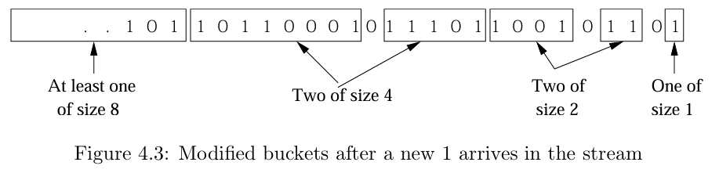

Example 4.13 describes how to update buckets when a new '1' arrives in the stream.
Initial Buckets: Start with the buckets from a previous figure.
New '1' Arrival: When a new '1' enters, create a new bucket of size 1 with the current timestamp.
Bucket Combination: If there are three buckets of size 1, combine the leftmost two into a single bucket of size 2.
Final Buckets: The updated sequence shows the modified buckets after the new '1' arrives, with annotations indicating bucket sizes.
The example demonstrates how the DGIM algorithm maintains approximate counts of 1s in a sliding window.

Slide 13
4.6.6 Reducing the Error
It explains a method for reducing error in representing numbers using buckets of exponentially growing sizes (1, 2, 4, ...). Instead of allowing only one or two of each size bucket, the method permits either r−1 or r of each size, for some integer r>2. This relaxation applies to both the smallest buckets and the largest size present, allowing any number from 1 to r of these buckets.
The process of combining buckets follows a rule similar to previous sections. If there are r+1 buckets of size 2ᶨ, the leftmost two are merged into a bucket of size 2ᶨ+1. This merging continues for larger sizes as needed.
This method results in a stronger error bound by having more buckets of smaller sizes. The largest relative error happens when only one bucket from the leftmost bucket b is within the query range, leading to an overestimation of the true count.

Slide 14
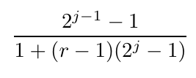
When 1's arrive in the stream, bucket sizes form consecutive binary integers, similar to the binary addition process. Two buckets of size 2ᶨ are represented as "1" in position j, and one bucket of size 2ᶨ is represented as "0" in that position.
Compares the long sequences of bucket combinations to the long rippling of carries in binary integers. This mathematical formula is provided to describe the overestimate and the fractional error in the bucket distribution:
The overestimate is 2ᶨ−1−1, and the fractional error is:
By selecting r large enough, the error can be limited to any desired fraction ϵ>0.

Slide 15
4.6.7 Extensions to the Counting of Ones
Counting Integers:
The goal is to estimate the sum of the last k integers in a stream (where 1≤k≤N).
Extending DGIM to both positive and negative integers is challenging due to potential large errors.
Challenges with Mixed Integers:
A stream with both large positive and negative integers can have a sum close to zero.
Any imprecision in estimating these large integers causes a significant error.
Using buckets to represent the sum of integers rather than the count of 1’s could lead to meaningless estimates. For example, a bucket might contain large negative integers in one half and equally large positive integers in the other, summing to zero. This sum makes it hard to estimate accurately.

Slide 16
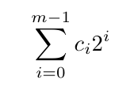
Handling Positive Integers:
Streams consisting only of positive integers in the range 1 to 2ᵐ can be managed by treating each bit of an integer as a separate stream.
The DGIM method can then count the 1’s in each bit.
If the count of the ith bit is cᵢ, the estimated sum’s error is at most ϵ.
the sum of the integers is:
Estimation Accuracy:
By estimating each bit's count with a fractional error no greater than ϵ, the true sum's error is bounded by ϵ. The worst-case scenario occurs when all bit counts are either overestimated or underestimated by the same fraction.

Slide 17
4.7 Decaying Windows
4.7.1 The Problem of Most-Common Elements
We want to track the "current" popularity of movies by evaluating recent ticket sales rather than historical sales. For instance, a movie that sold consistently in recent weeks is more popular than one that had a spike last week and nothing before.

Slide 18
Proposed Solution:
Bit Stream Representation: Imagine a bit stream for each movie, where the ith bit is 1 if the ith ticket is for that movie, and 0 otherwise.
Window Size: Choose a window size N, which represents the number of most recent tickets considered for evaluating popularity.
Popularity Estimation: Use the method from Section 4.6 to estimate ticket counts for each movie within the window and rank them by these estimates.
Challenges:
Scalability: This method works for movies because there are only thousands of them. It would not scale for other domains with too many items, like products on Amazon or tweets by different Twitter users.
Approximation: The technique only provides approximate answers, not exact counts.

Slide 19

4.7.2 Definition of the Decaying Window
Definition of the Decaying Window
Instead of simply counting the number of 1s in a window, it calculates a weighted sum where more recent 1s have higher weights.
The stream elements are denoted as a₁,a₂,...,aₜ, where a₁ is the first element and aₜ is the most recent. A small constant c (e.g., 10⁻⁶or 10⁻⁹) is used for weighting, and thedecaying sum is defined as:
This formula ensures that the weights of older elements decay exponentially over time.

Slide 20
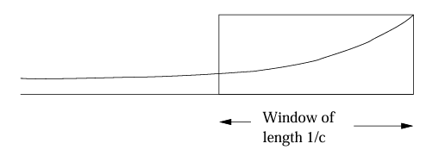
Maximum Weight Window
The maximum weight window is achieved when the current position is just one element (1/c) from its previous position. In this case, the window's weight is 1. It means that after approximately 1/c elements, the weights of previous elements become negligible, ensuring efficient space usage.
Figure 4.4 compares a fixed-length window with an exponentially decaying window, highlighting how the decaying window provides more weight to recent elements.
Figure 4.4

Slide 21
In a sliding window of fixed length, each new element forces us to remove the oldest element, requiring us to keep track of all exact elements and their sum.
Using an exponentially decaying window simplifies this process, as there is no need to track which element leaves the window.
Adjustment Steps:
When a new element aₜ+1 arrives at the stream input, the sum is adjusted as follows:
Multiply Current Sum: Multiply the current sum by (1−c). This reflects that all previous elements have moved one position further away, so their weights decrease by this factor.
Add New Element: Add aₜ+1. The weight of the new element is 1 since (1−c)0=1.
Why This Method Works:
Each previous element’s weight decreases exponentially as it moves further from the current element.
The new element’s contribution is added correctly because its initial weight is 1.
This method ensures efficient computation and storage by simplifying the way we handle incoming data while keeping accurate, up-to-date results.

Slide 22
4.7.3 Finding the Most Popular Elements
This part is a detailed section on "Finding the Most Popular Elements" using the DGIM (Datar-Gionis-Indyk-Motwani) algorithm with an exponentially decaying window. The goal is to identify the most popular movies in a continuous stream of ticket sales.
Concept:
Each ticket sale is represented as a 1 for the sold movie and a 0 for others.
The decaying window approximates the last one billion ticket sales, using a constant c≈10⁻⁹.

Slide 23
Steps in the Algorithm:
Multiply Scores: Each movie's score is multiplied by (1−c) to decay over time.
Update Score: If a new ticket is for a movie M, add 1 to its score. If there's no score for M, initialize it at 1.
Remove Low Scores: Drop scores below the threshold 1/2. This reduces storage by only keeping popular movies.
Efficiency:
Maintains at most 2/c movies with scores of 1/2 or more.
Sum of all scores is 1/c.

Slide 24
Popularity Calculation:
For each new ticket:
Multiply the score of each tracked movie by (1−c), decaying the score.
Add 1 to the score if the ticket is for that movie, or create a new score if it's the first ticket for that movie.
Remove any movie whose score falls below the threshold 1/2, effectively discarding unpopular movies.
Practical Application:
Despite the theoretical limit of 2/c, in practice, only a small number of movies need to be actively tracked due to the natural distribution of ticket sales.
This method allows for efficient, realtime tracking of movie popularity while keeping storage requirements manageable.

Slide 25


Thanks for listening!

